Slide 1
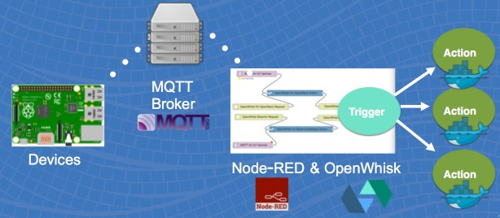
How to build a Distributed Serverless Polyglot Microservices IoT Platform using Docker and OpenWhisk
n
ICICI Appathon 2017
by SirAbhinavJain

Slide 2
Cloud Computing Evolution
PaaS
Container Orchestrators
IaaS
Bare Metal
ICICI Appathon 2017 by SirAbhinavJain

Slide 3


Problem: It’s expensive to scale microservices, even on a PaaS
Explosion in number of containers / processes:
Increase of infrastructure cost footprint
Increase of operational management cost and complexity
Monolithic application
Break-down into microservices
Make each micro service HA
Protect against regional outages
Region A
Region B
ICICI Appathon 2017 by SirAbhinavJain

Slide 4



Problem: the programming and cost model doesn’t help
1a 1b
Request Polling
Continuous polling needed in the absence of an event driven programming model.
Charged for resources, even when idle.
2
Application
Worries persist about capacity management.
CF
Container VM
Swift
ICICI Appathon 2017 by SirAbhinavJain

Slide 5
Enter Serverless!
Serverless
PaaS
Container Orchestrators
IaaS
Bare Metal
ICICI Appathon 2017
by SirAbhinavJain

Slide 6










What is Serverless?
event handlers
events
a cloud-native platform
for
short-running, stateless computation
and
event-driven applications
which
scales up and down instantly and automatically
and
charges for actual usage at a millisecond granularity
ICICI Appathon 2017 by SirAbhinavJain

Slide 7
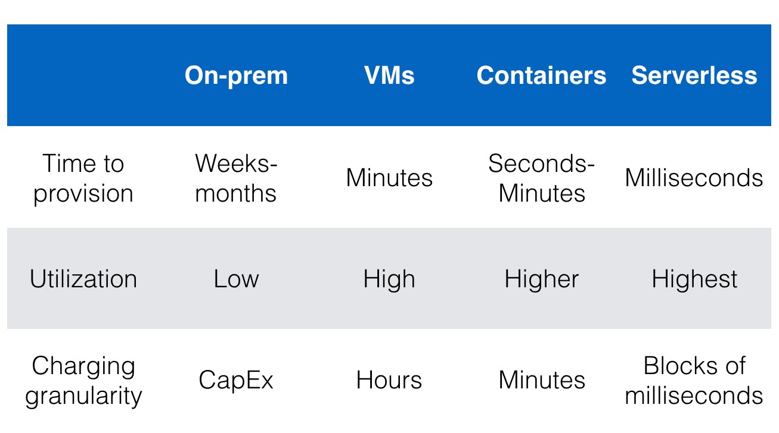
Why is Serverless attractive?
Short answer:
Besides
making app development & ops dramatically faster, cheaper, easier (but different J ), it
Drives infrastructure cost savings
(yes – this has been true for most IT innovations over the last decades, while serverless potentially introduces another step-function change)
ICICI Appathon 2017
by SirAbhinavJain

Slide 8
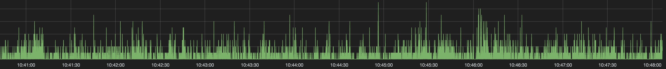
Key factors for infrastructure cost savings
 | Traditional models (CF, containers, VMs) | Serverless
High Availability | At least 2-3 instances of everything | No incremental infrastructure
Multi-region deployment | One deployment per region | No incremental infrastructure
Cover delta between short (<10s) load spikes and valleys (vs average) | ~2x of average load | No incremental infrastructure
Example incremental costs | 2 instances x 2 regions x 2 = 8x | 1x
ICICI Appathon 2017
by SirAbhinavJain

Slide 9
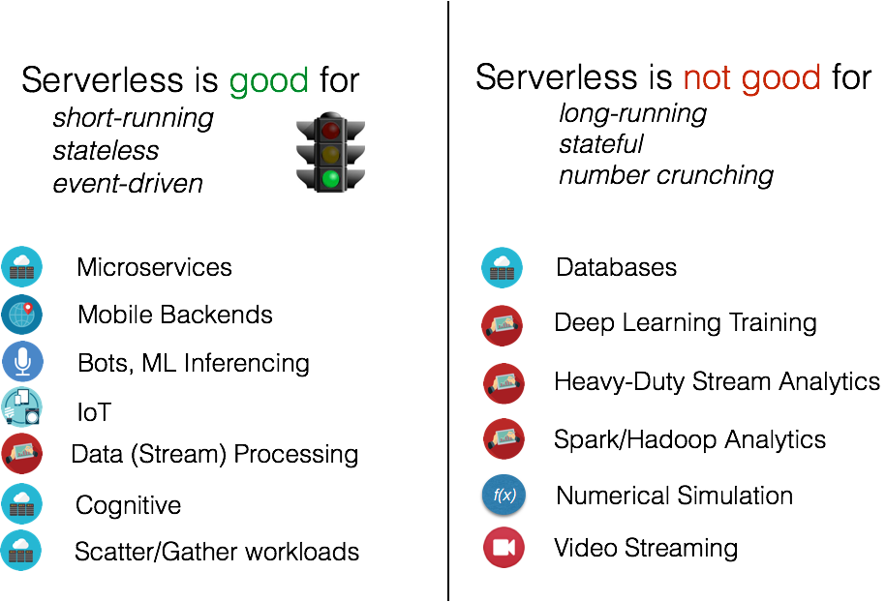
What is Serverless good for?
ICICI Appathon 2017
by SirAbhinavJain

Slide 10
Introducing OpenWhisk, a fabric and platform for
the serverless, event driven programming model

Slide 11
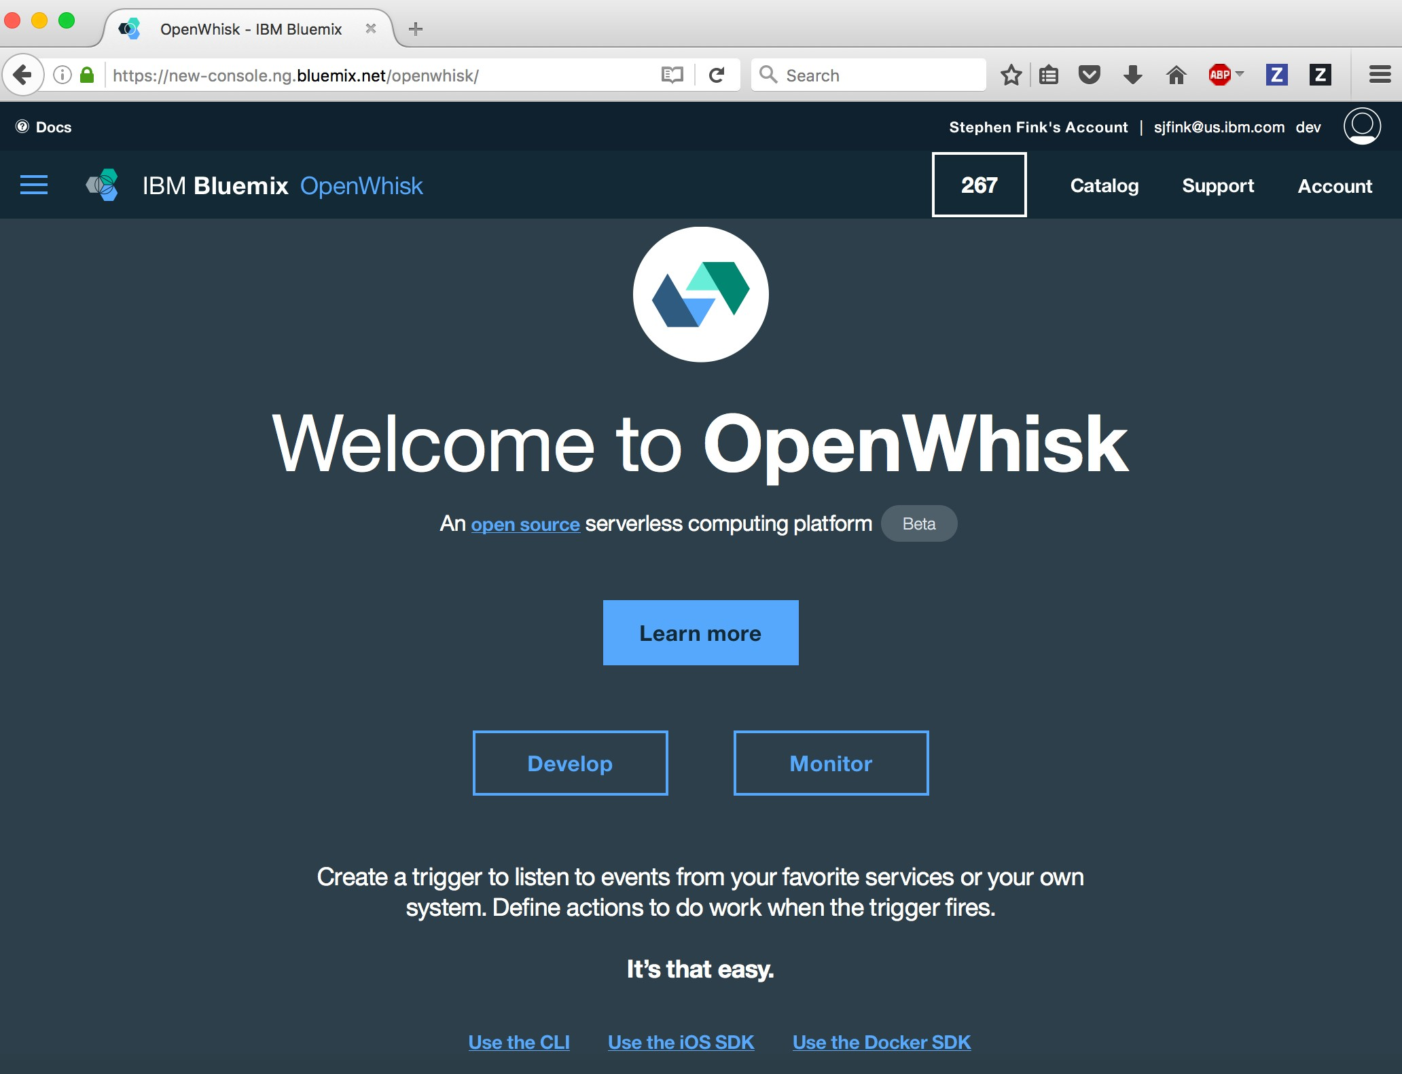
What is OpenWhisk?
an open Beta offering in IBM’s Bluemix cloud
ICICI Appathon 2017
by SirAbhinavJain

Slide 12
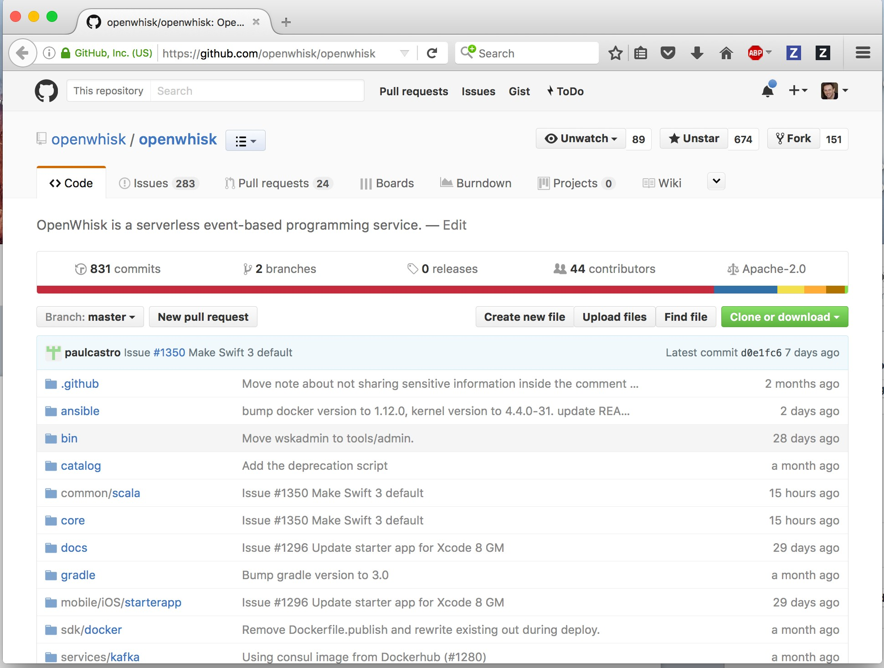
What is OpenWhisk?
an open-source project on github
ICICI Appathon 2017
by SirAbhinavJain

Slide 13
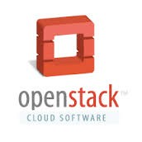
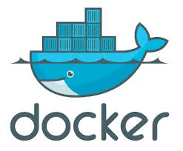


What is OpenWhisk?
another way to build apps….
Build your apps, your way.
Use a combination of the most prominent open-source compute technologies to power your apps. Then, let Bluemix handle the rest.
IaaS
Containers
PaaS
Functions
Full stack Control
Ease of getting started
ICICI Appathon 2017
by SirAbhinavJain

Slide 14
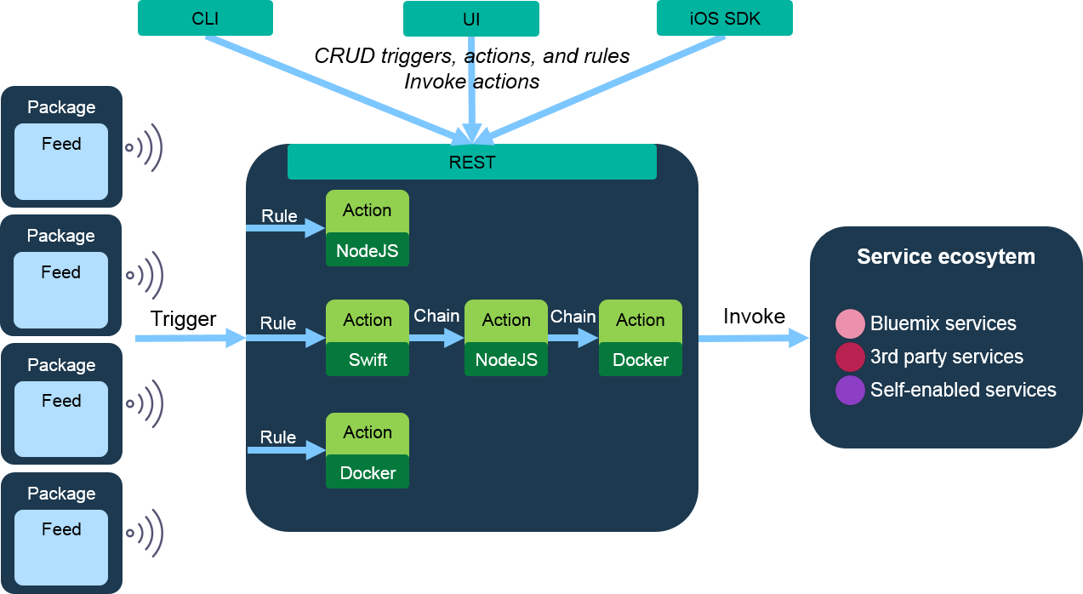
What is OpenWhisk?
a distributed compute service to execute application logic in response to events.
ICICI Appathon 2017
by SirAbhinavJain

Slide 15



OpenWhisk: How does it work?
1
2
Invoke associated OpenWhisk action
„getCustomers“
Browser
Incoming HTTP request, e.g. HTTP GET
openwhisk.ng.bluemix.net/api/v1/<namespace>/actions/getCustomers
Web App
Mobile App
OpenWhisk
Variety of languages
JS Swift
Python Java*
Docker
ICICI Appathon 2017
by SirAbhinavJain
* work in progress

Slide 16



OpenWhisk: How does it work?
Coming soon...
1
2
3
Invoke associated OpenWhisk action
„getCustomers“
Browser
Incoming HTTP request, e.g. HTTP GET
api-gw.mybluemix.net/…/getCustomers
Web App
API Gateway
Mobile App
OpenWhisk
API Gateway takes care of…
security (authenticate, authorize, threat protect, validate)
control (rate limiting, response caching)
mediation
parameter mapping
schema validation
- … and supports e.g. different verbs (Get, Post, Put, Delete, …)
JS Swift
Python Java*
Docker
ICICI Appathon 2017
by SirAbhinavJain
* work in progress

Slide 17
The OpenWhisk programming model

Slide 18

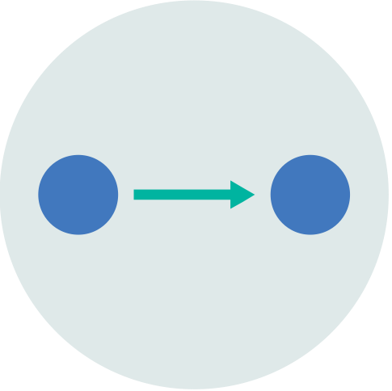
What is OpenWhisk?
a high-level serverless programming model
Package
Trigger
Action
Rule

Slide 19
What is OpenWhisk?
a high-level serverless programming model
language support to encapsulate, share, extend code
all constructs first-class
— powerful extensible language
Package
first-class functions compose via sequences
Trigger
Action
Rule
first-class event-driven
programming constructs
docker containers as actions

Slide 20













Programming model
T
Trigger: A class of events that can happen
ICICI Appathon 2017
by SirAbhinavJain

Slide 21





Programming model
A
Actions: An event-handler, i.e. code that runs in response to an
event
ICICI Appathon 2017
by SirAbhinavJain

Slide 22


Programming model
A
Actions: Multi-runtime support, e.g. JavaScript
function main(msg) {
return { message: 'Hello, ' + msg.name + ' from ' + msg.place };
};
ICICI Appathon 2017
by SirAbhinavJain

Slide 23



Programming model
A
Actions: Multi-runtime support, e.g. Swift
func main(params:[String:Any]) -> [String:Any] { var reply = [String:Any] ()
if let name = params[“name”] as? String { print(“Hello \(name)”)
reply[“msg”] = “Goodbye \(name)”
}
return reply
}
ICICI Appathon 2017
by SirAbhinavJain

Slide 24




Programming model
A
Actions: In any other language by packaging with Docker
ICICI Appathon 2017
by SirAbhinavJain

Slide 25





Programming model
R
Rules: An association of a trigger and an action
R
:=
T
A
ICICI Appathon 2017
by SirAbhinavJain

Slide 26

















Programming model
A
Actions: Can be chained to create sequences to increase flexibility and foster reuse
A_{A} := A₁ + A₂ +
A₃
A_{B} := A₂ + A₁ +
A₃
A_{C} := A₃ + A₁ +
A₂
ICICI Appathon 2017
by SirAbhinavJain

Slide 27

























Programming model
P
Packages: A shared collection of triggers and actions
A A
read write changes
T
A
translate
A
forecast
Open Source
post topic
Third Party
Yours
myAction myFeed
A
A
T
T
commit
T
ICICI Appathon 2017
by SirAbhinavJain

Slide 28
OpenWhisk
backend architecture

Slide 29




OpenWhisk on Bluemix
github.com openwhisk/openwhisk
monitoring
logging
billing
core runtime
security features
persistent store
authenticati on
packages
CLI
ICICI Appathon 2017
by SirAbhinavJain

Slide 30
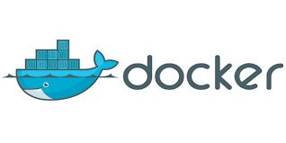





















OpenWhisk Open Source Core Runtime
Master
Slave
Edge
ontroller
Edge
^{c} Edge
invoker
VM
VM
Edge
EdgeEdge
VM
Edge
VM
VM
VM
action
container
action
container
action
container
action
container
action
container
action
container
action
container
action container
microservices deployed in docker containers
open-source system middleware
NoSQL (CouchDB) persistence
ICICI Appathon 2017
by SirAbhinavJain

Slide 31
Why Docker?

Slide 32








Why Docker?
1
Deploying and managing traditional microservices
controller
invoker
ICICI Appathon 2017
by SirAbhinavJain

Slide 33



Why Docker?
2
Lightweight isolated execution environment for arbitrary user code
Slave VM
on container
acti
acti
acti
acti
acti
acti
on container
on container
on container
on container
on container
acti
on container
action container
ICICI Appathon 2017
by SirAbhinavJain

Slide 34

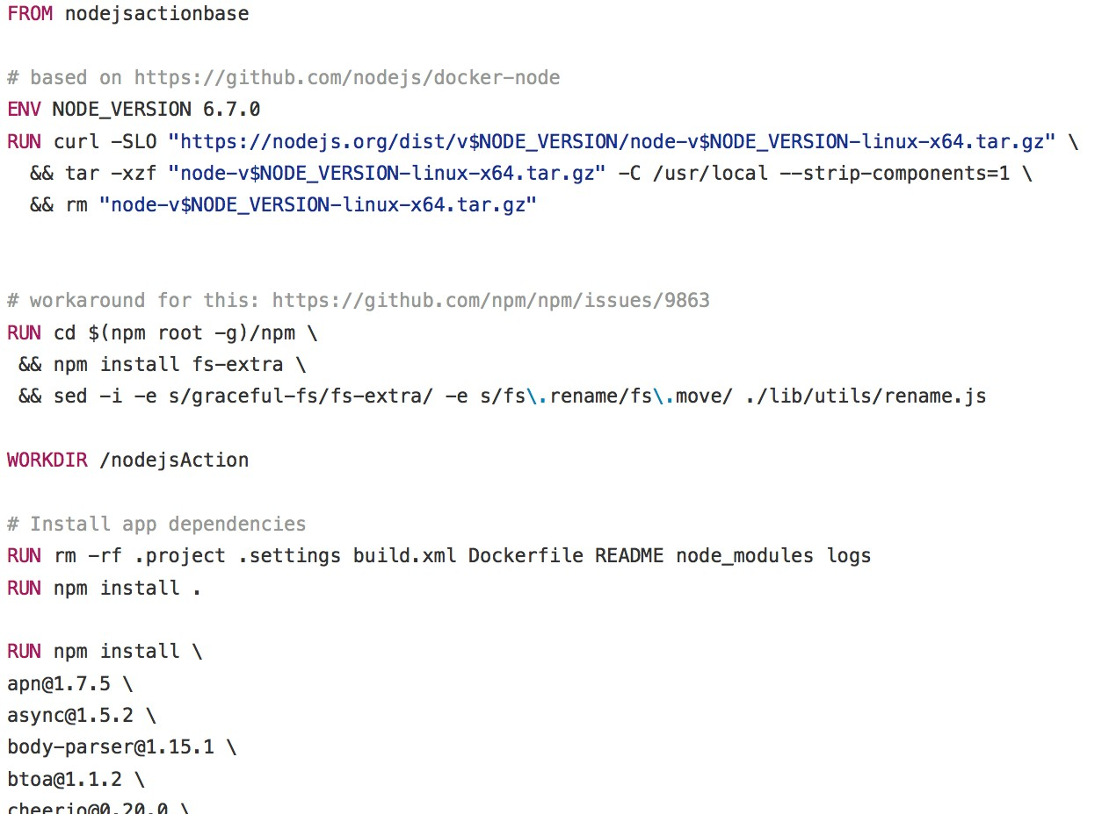
Why Docker?
3
Portable description of arbitrary binary user actions (Dockerfile)
Docker file
ICICI Appathon 2017
by SirAbhinavJain

Slide 35

How it all works?
% wsk action invoke hello
in 8 easy steps
POST /api/v1/namespaces/myNamespace/actions/myAction
ICICI Appathon 2017
by SirAbhinavJain

Slide 36



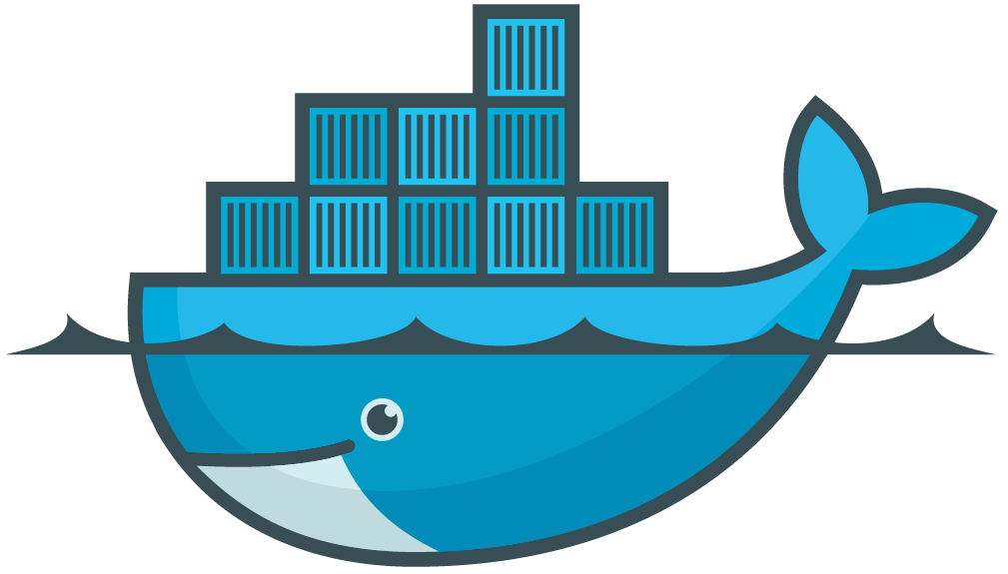
OpenWhisk Topology
1
3,4
Controller
2
5
8
6
Invoker
Invoker
7
Invoker
…
36

Slide 37




OpenWhisk Topology in Bluemix
Controller
Cloudant
ELK-Stack
Integration Service
Monitoring
Invoker
Invoker
Invoker
…
ICICI Appathon 2017
by SirAbhinavJain

Slide 38




OpenWhisk: Usage of Docker
Isolation of actions
Control over consumed resources of each container
=≈
A
wsk action invoke
docker run
ICICI Appathon 2017
by SirAbhinavJain

Slide 39

OpenWhisk: Container startup
Start container
docker run
Initialize
/init
Run
/run
cold container
ICICI Appathon 2017
by SirAbhinavJain

Slide 40
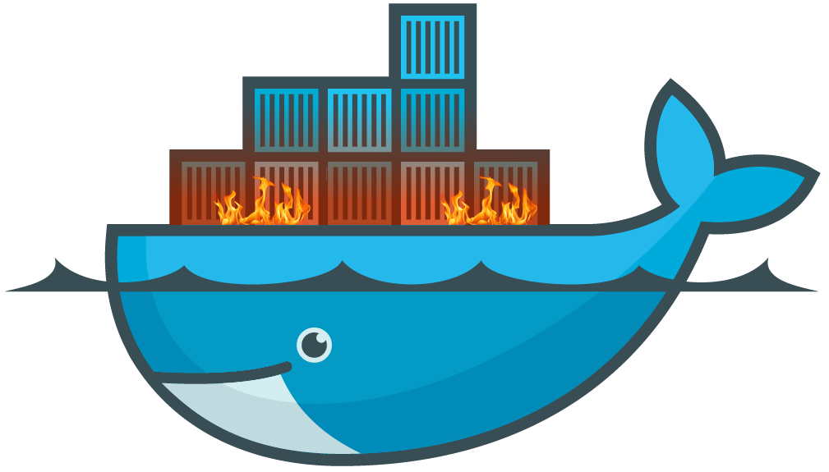
OpenWhisk: Container startup
Start container
docker run
Initialize
/init
Run
/run
pre-warmed container
ICICI Appathon 2017
by SirAbhinavJain

Slide 41
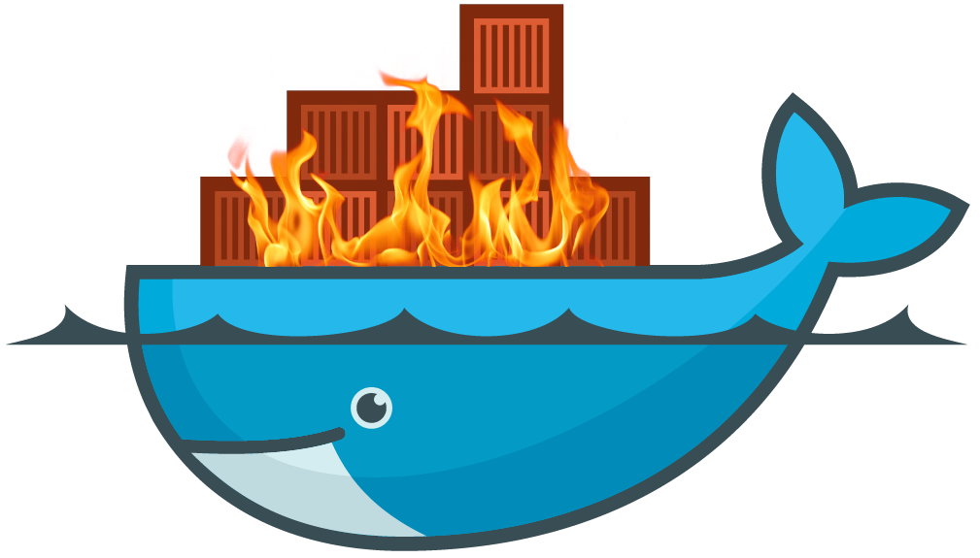
OpenWhisk: Container startup
Start container
docker run
Initialize
/init
Run
/run
warm container
ICICI Appathon 2017
by SirAbhinavJain

Slide 42
OpenWhisk: Container startup optimization
Performance is king.
cold container
pre-warmed container
warm container
faster
ICICI Appathon 2017
by SirAbhinavJain

Slide 43
IoT Usecase
Node-RED and MQTT

Slide 44
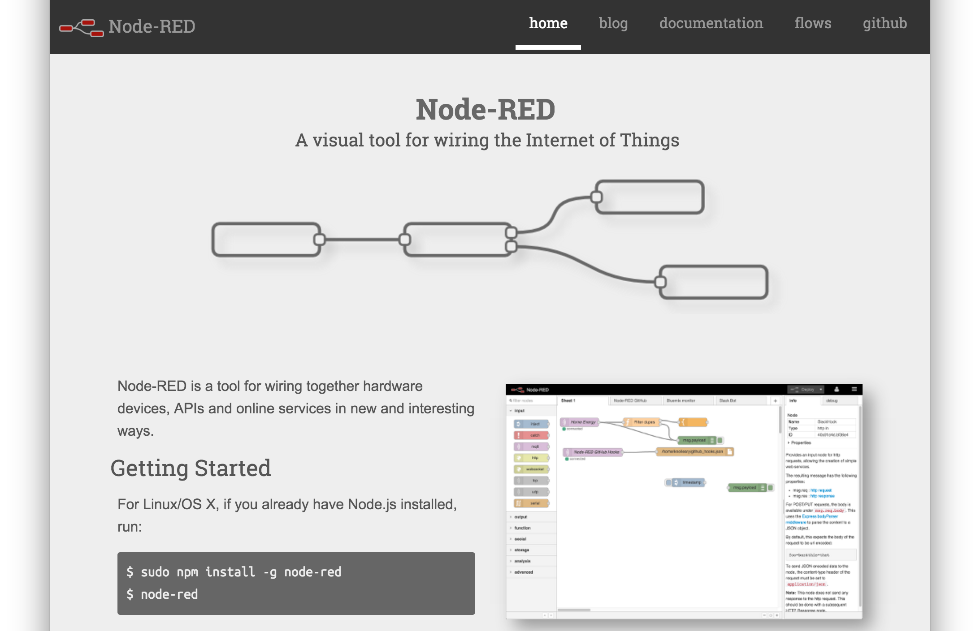

Slide 45
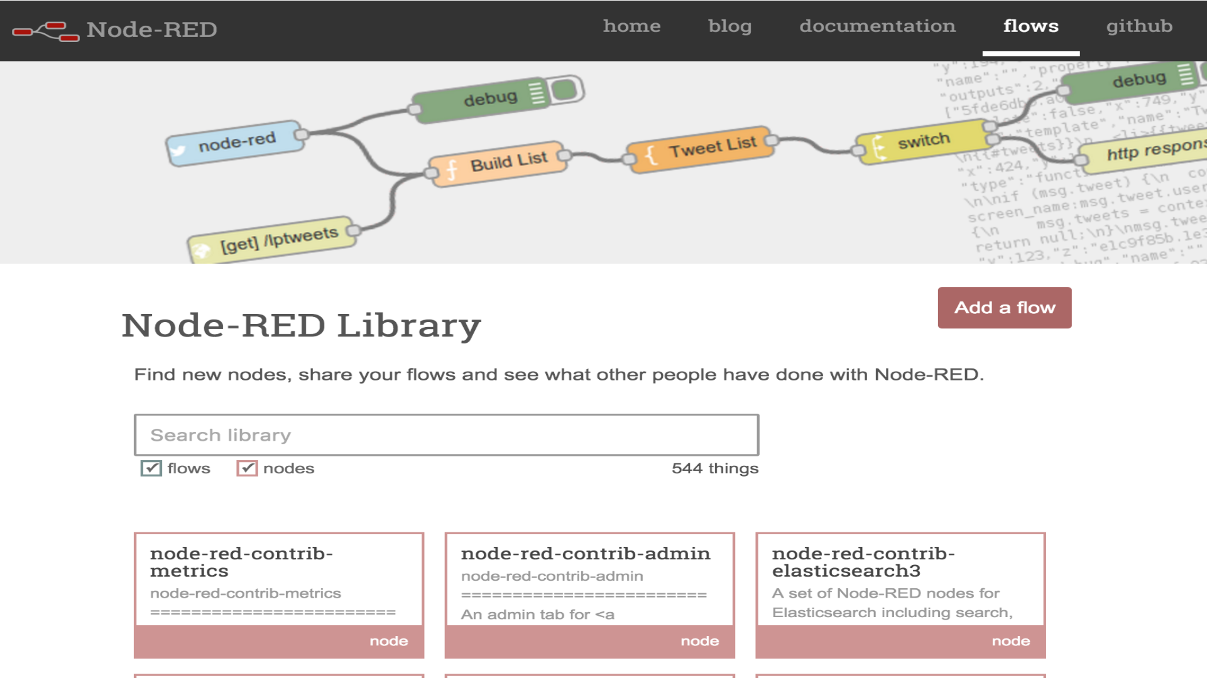

Slide 46
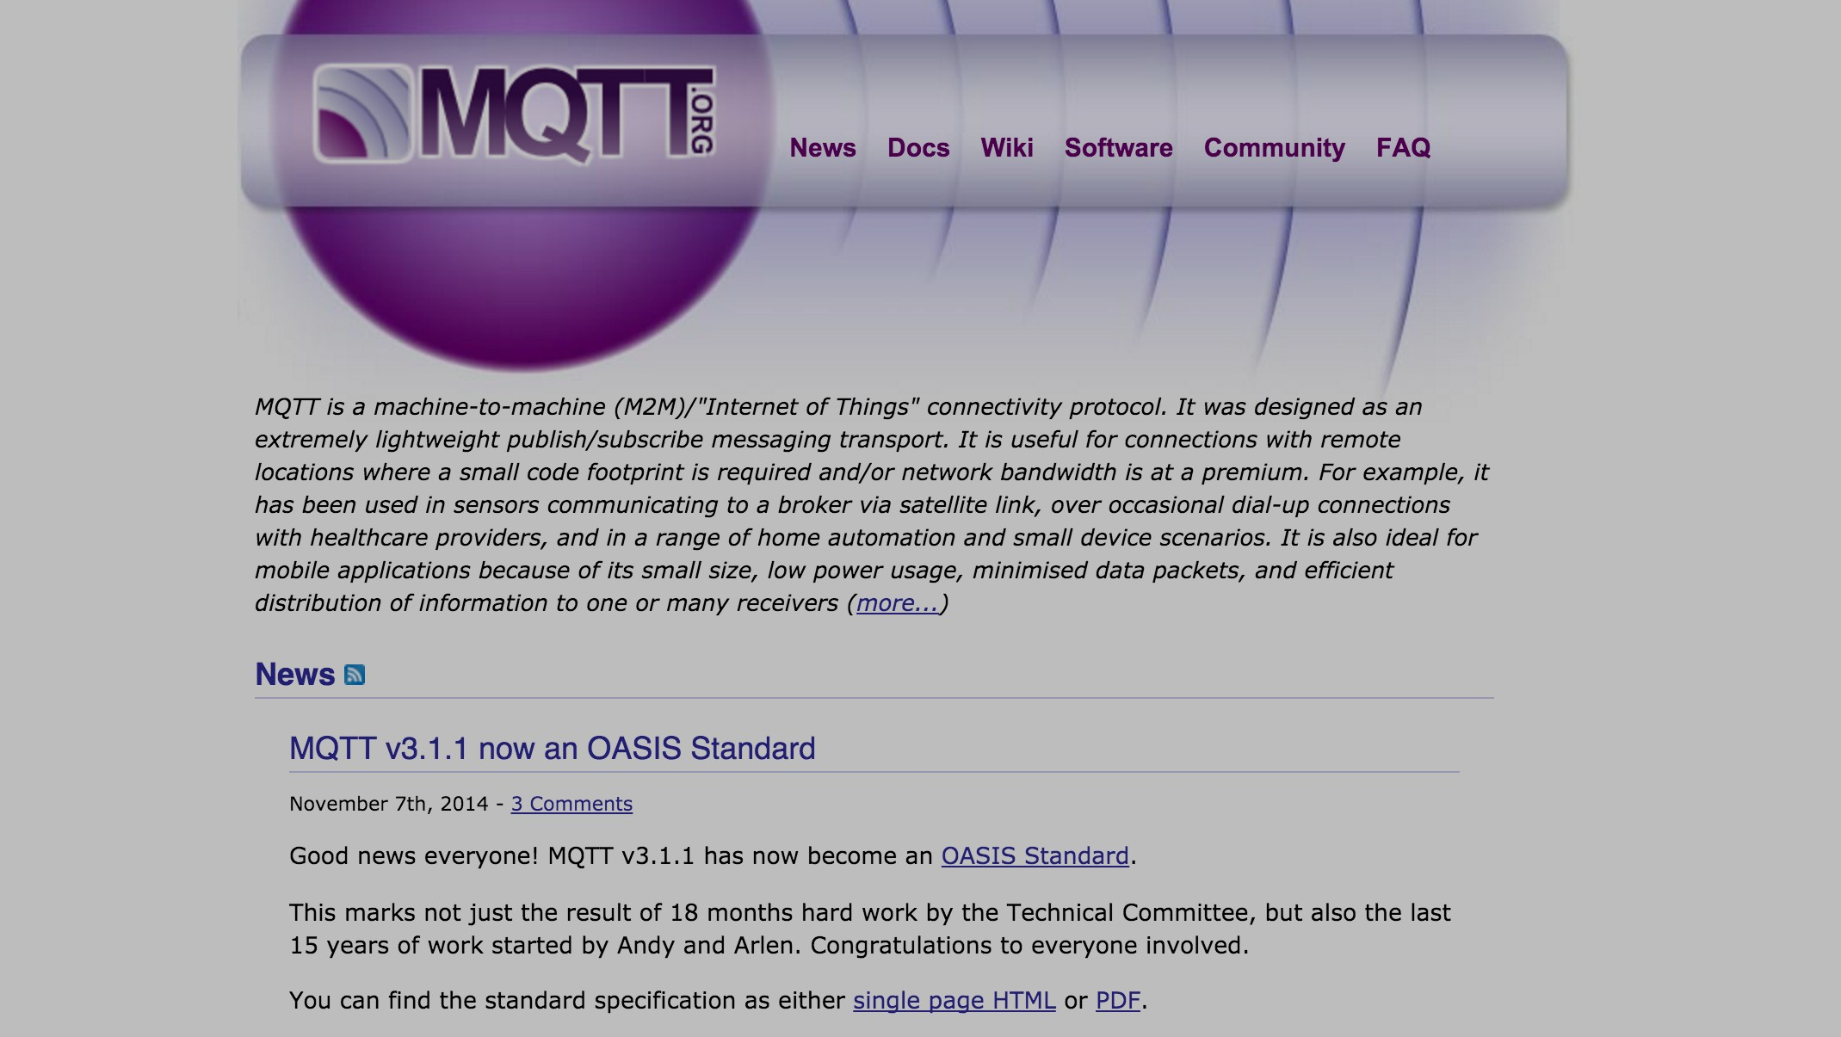
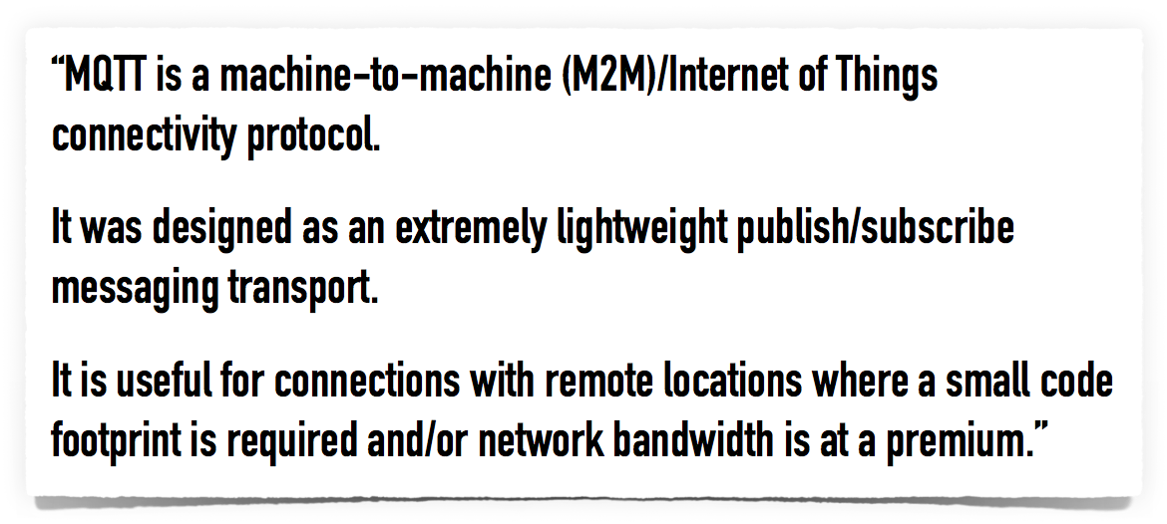

Slide 47
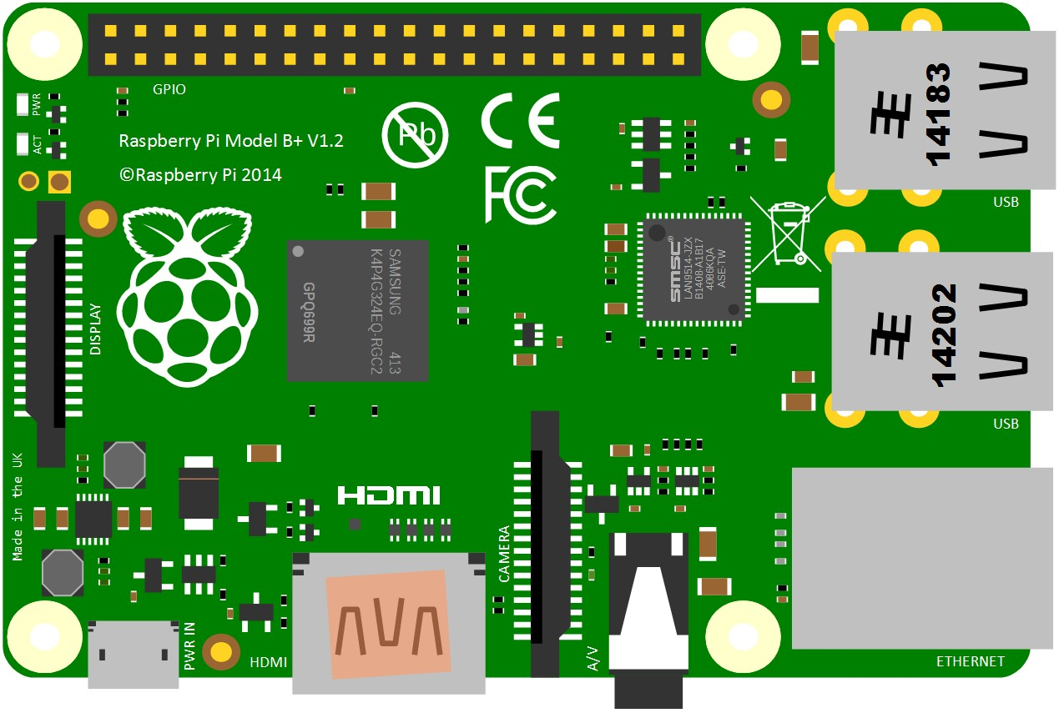
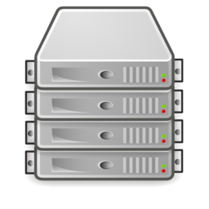
CLIENTS
BROKER
ICICI Appathon 2017
by SirAbhinavJain

Slide 48
{…}
{…}
{…}
PUBLISH
{…}

Slide 49

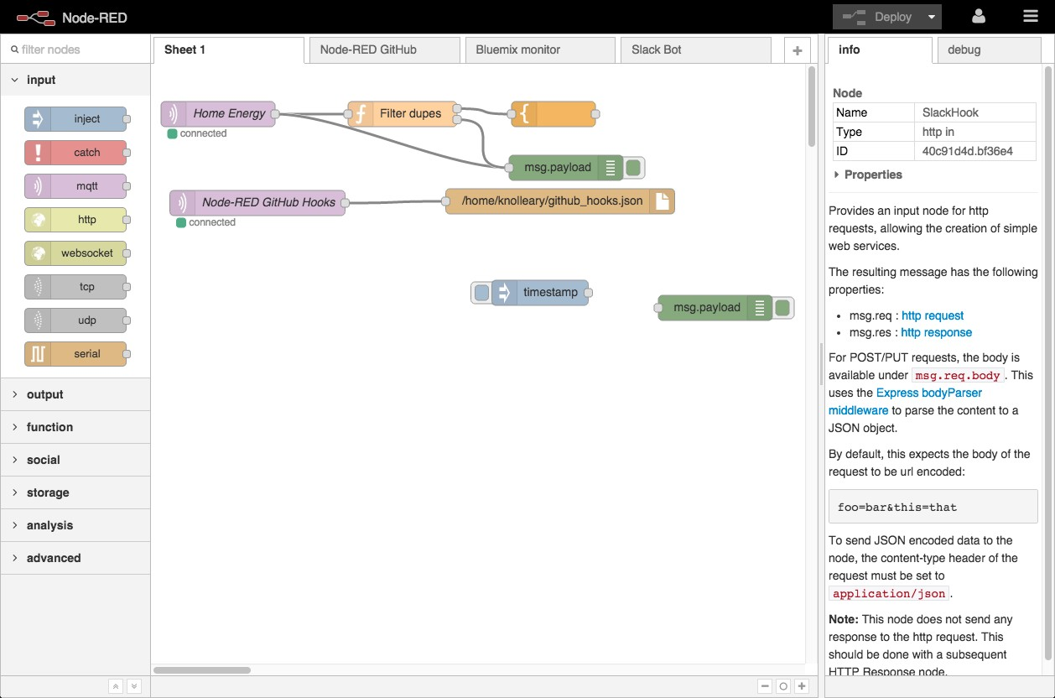
BROKER
NODE-RED
DEVICES

Slide 50
OpenWhisk Feeds
and creating MQTT feeds

Slide 51


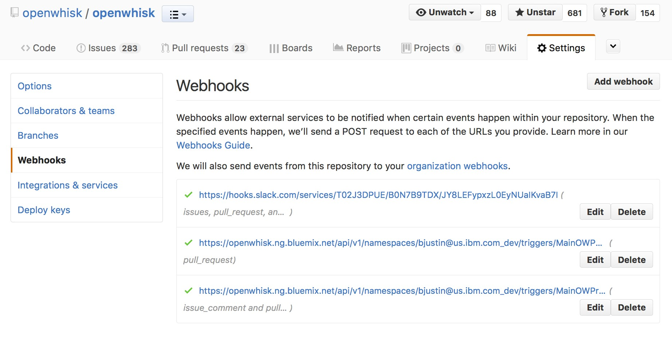





CUSTOM FEED EXAMPLE
Action
Trigger
Action
Action
push,
fork,
comment, ..

Slide 52


anybody can create a Package with a feed
/whisk.system/github
/mynamespace/github

Slide 53
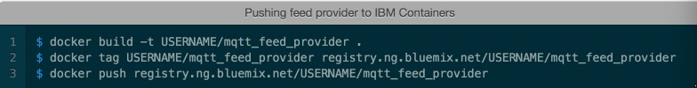
MQTT feeds for OpenWhisk
http://jamesthom.as/blog/2016/06/15/openwhisk-and-mqtt/
Bridging MQTT messages to OpenWhisk Actions can be achieved by creating a new Feed provider. This provider would subscribe to message topics and execute registered Triggers with incoming messages.
The custom feed provider would need to establish and maintain long-lived MQTT connections, waiting for messages to arrive. This requirements means the Feed provider needs an external service to handle managing these connections, it won’t be possible within the Feed Action.
This feed provider service is implemented using Node.js, using Cloudant for the database. The service listens for HTTP requests, with Trigger registration details, from the Feed Action. The Node.js MQTT library is used to subscribe to registered topics. When messages are received, the OpenWhisk client library is used to invoke the Trigger remotely, passing the message contents as event parameters.
This service provider is packaged using Docker. Pushing this image into the IBM Containers registry, the Feed provider can be started on IBM Bluemix using the Containers service.

Slide 54
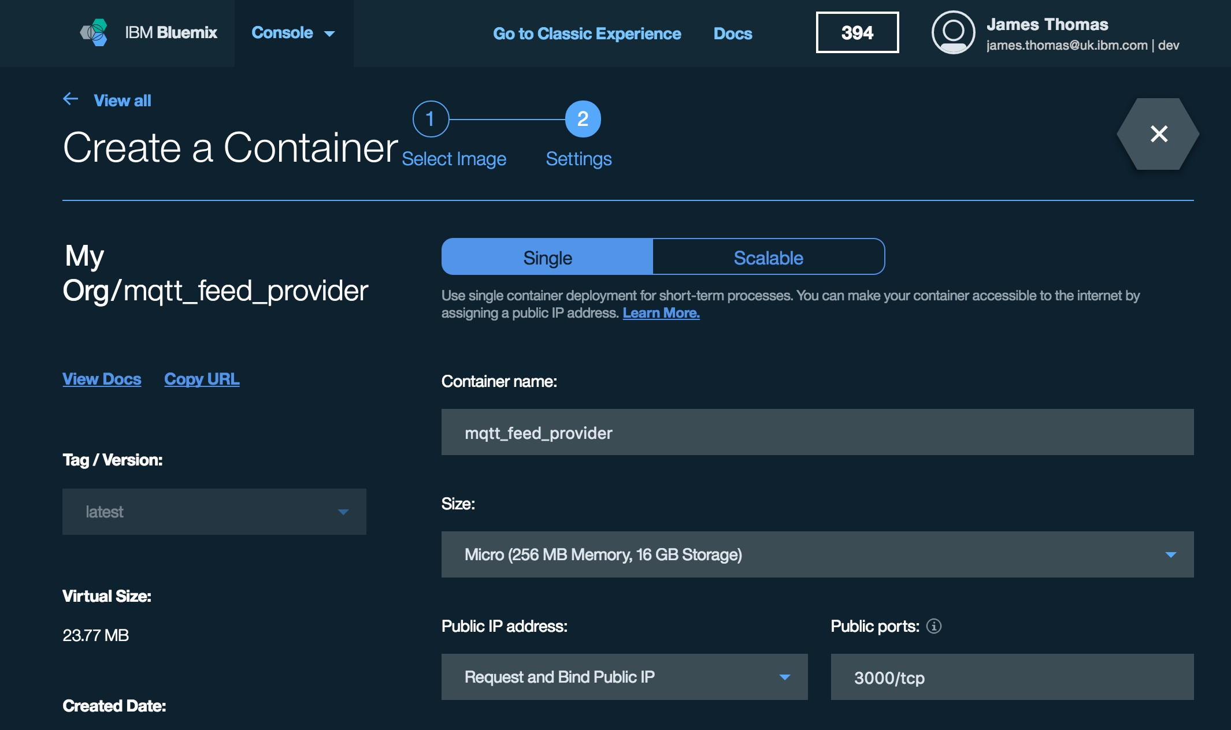
MQTT feeds for OpenWhisk
• This service provider is packaged using Docker.
• Pushing this image into the IBM Containers registry, the Feed provider can be started on IBM Bluemix using the Containers service.

Slide 55
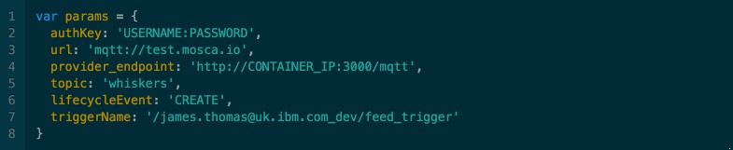
Registering Feeds
http://jamesthom.as/blog/2016/06/15/openwhisk-and-mqtt/

Slide 56
Node-RED for Serverless OpenWhisk

Slide 57
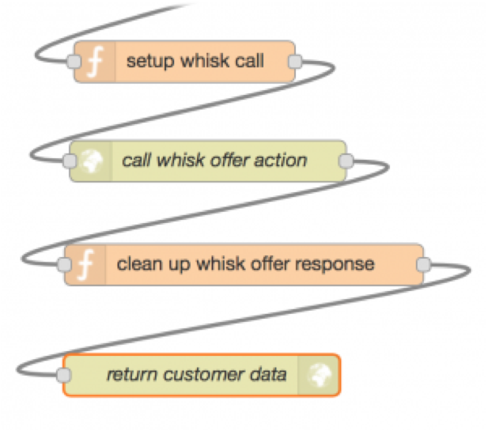
Node-RED and OpenWhisk
Community effort to integrate with open tools: NodeRED
NodeRED is all about automating flows to orchestrate calls to different service APIs
Usually triggered by calls from external systems or devices
Runs within a long-running single node process, with a dedicated amount of CPU & memory being allocated
OpenWhisk is all about executing code (custom logic) in response to events on a scalable platform, with a dedicated amount of CPU & memory being allocated per-request
NodeRED and OpenWhisk complement each other
Use NodeRED to graphically create flows, automating a series of tasks in a kind of workflow
Use OpenWhisk to execute custom logic (requiring some kind of CPU- or memory bound operation) triggered from within NodeRED

Slide 58
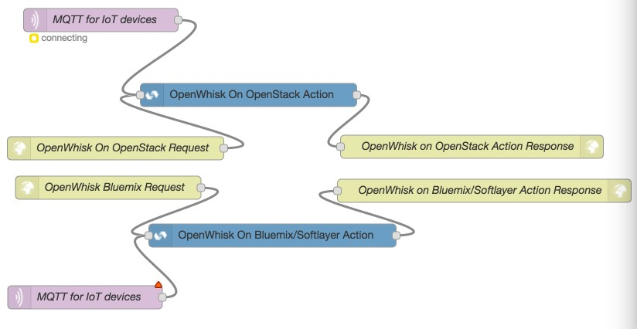
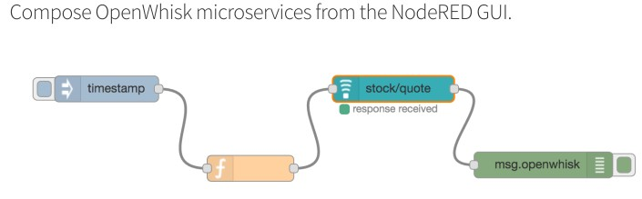
Use Node-RED to compose Serverless Applications
Use Node-RED to create Multi cloud Serveless Applications!
$ wsk property set --apihost openwhisk.ng.bluemix.net --auth 96294c7b- e6f4-4ccf --namespace “animeshsingh"
{
"message": "hello"
}
$ wsk action invoke /whisk.system/utils/ echo -p message hello --blocking --result

Slide 59









Bringing it all together – Serverless IoT Applications
Action
MQTT
Broker
Devices
Trigger
Action
Node-RED & OpenWhisk
Action

Slide 60
Summary

Slide 61
What you learned today
We’re in the early days of an evolution that is empowering developers to write cloud native applications better, faster, and cheaper
OpenWhisk provides an open source platform to enable cloud native, serverless, event driven applications
OpenWhisk, MQTT and Node-RED can be used together to create IoT Serverless applications

Slide 62
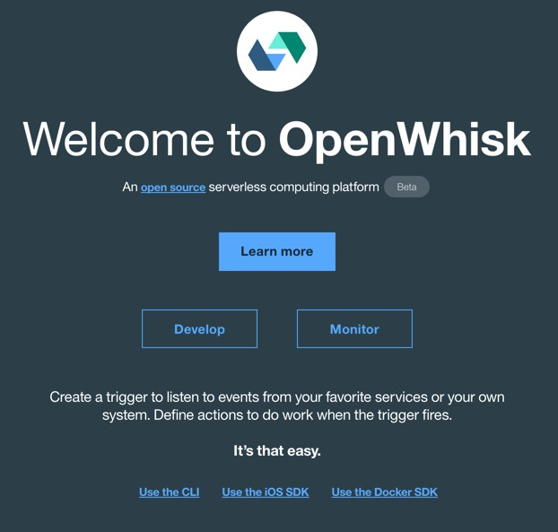
Experiment with OpenWhisk on Bluemix
bit.ly/ow-bm

Slide 63


Join us to build a cloud native platform for the future!
OpenWhisk.org
dwopen.slack.com #openwhisk
bluemix.net
OpenWhisk and MQTT http://jamesthom.as/blog/2016/06/15/openwhisk-and-mqtt/

Slide 64
Thank You

